Slide 1



Hr Analytics Report
View in Power BI
Last data refresh:
7/8/2024 12:20:32 AM UTC
Downloaded at:
7/8/2024 12:25:12 AM UTC

Slide 2
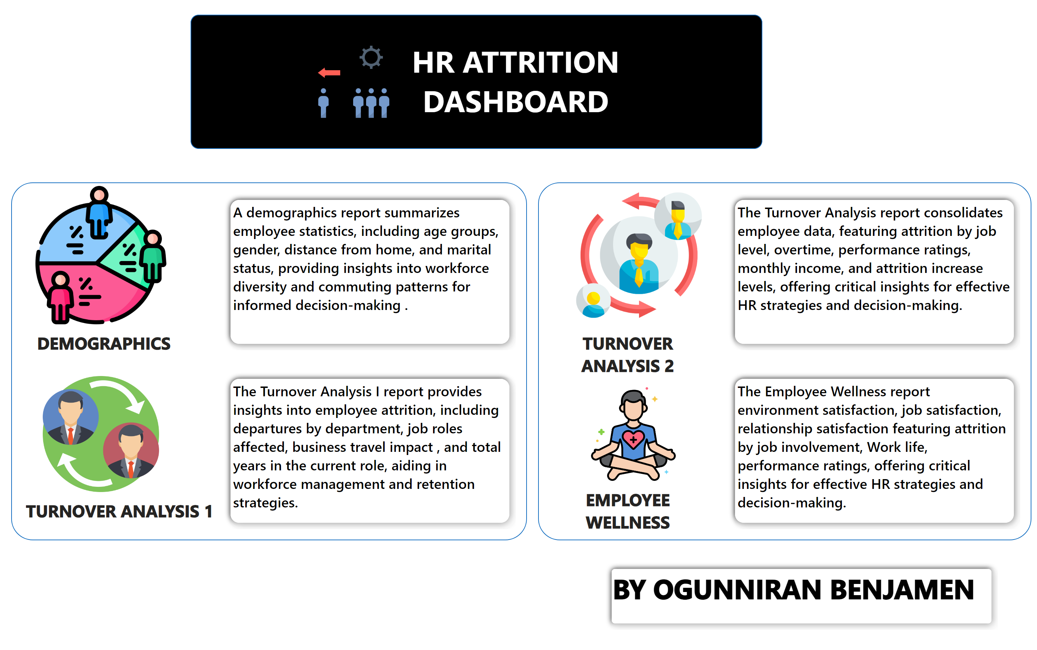
Overview
Notes:
shape
No alt text provided
image
No alt text provided
textbox
No alt text provided
shape
No alt text provided
shape
No alt text provided
image
No alt text provided
textbox
No alt text provided
image
No alt text provided
image
No alt text provided
textbox
No alt text provided
shape
No alt text provided
shape
No alt text provided
textbox
No alt text provided
image
No alt text provided
textbox
No alt text provided
shape
No alt text provided
shape
No alt text provided
shape
No alt text provided

Slide 3
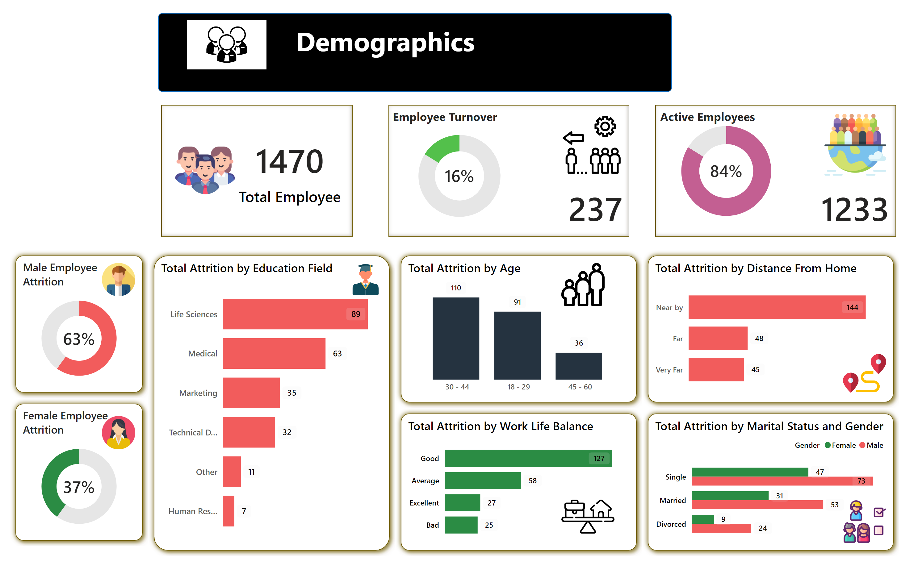
Demographics
Notes:
shape
No alt text provided
textbox
No alt text provided
image
No alt text provided
cardVisual
No alt text provided
Attrition = Yes
No alt text provided
donutChart
No alt text provided
card
No alt text provided
cardVisual
No alt text provided
donutChart
No alt text provided
card
No alt text provided
shape
No alt text provided
Total Attrition by Education Field
No alt text provided
shape
No alt text provided
Total Attrition by Age
No alt text provided
shape
No alt text provided
shape
No alt text provided
Total Attrition by Work Life Balance
No alt text provided
Total Attrition by Distance From Home
No alt text provided
shape
No alt text provided
Total Attrition by Marital Status and Gender
No alt text provided
shape
No alt text provided
shape
No alt text provided
Female Employee Attrition
No alt text provided
Male Employee Attrition
No alt text provided
card
No alt text provided
card
No alt text provided
image
No alt text provided
image
No alt text provided
image
No alt text provided
image
No alt text provided
image
No alt text provided
image
No alt text provided
image
No alt text provided
textbox
No alt text provided
textbox
No alt text provided

Slide 4
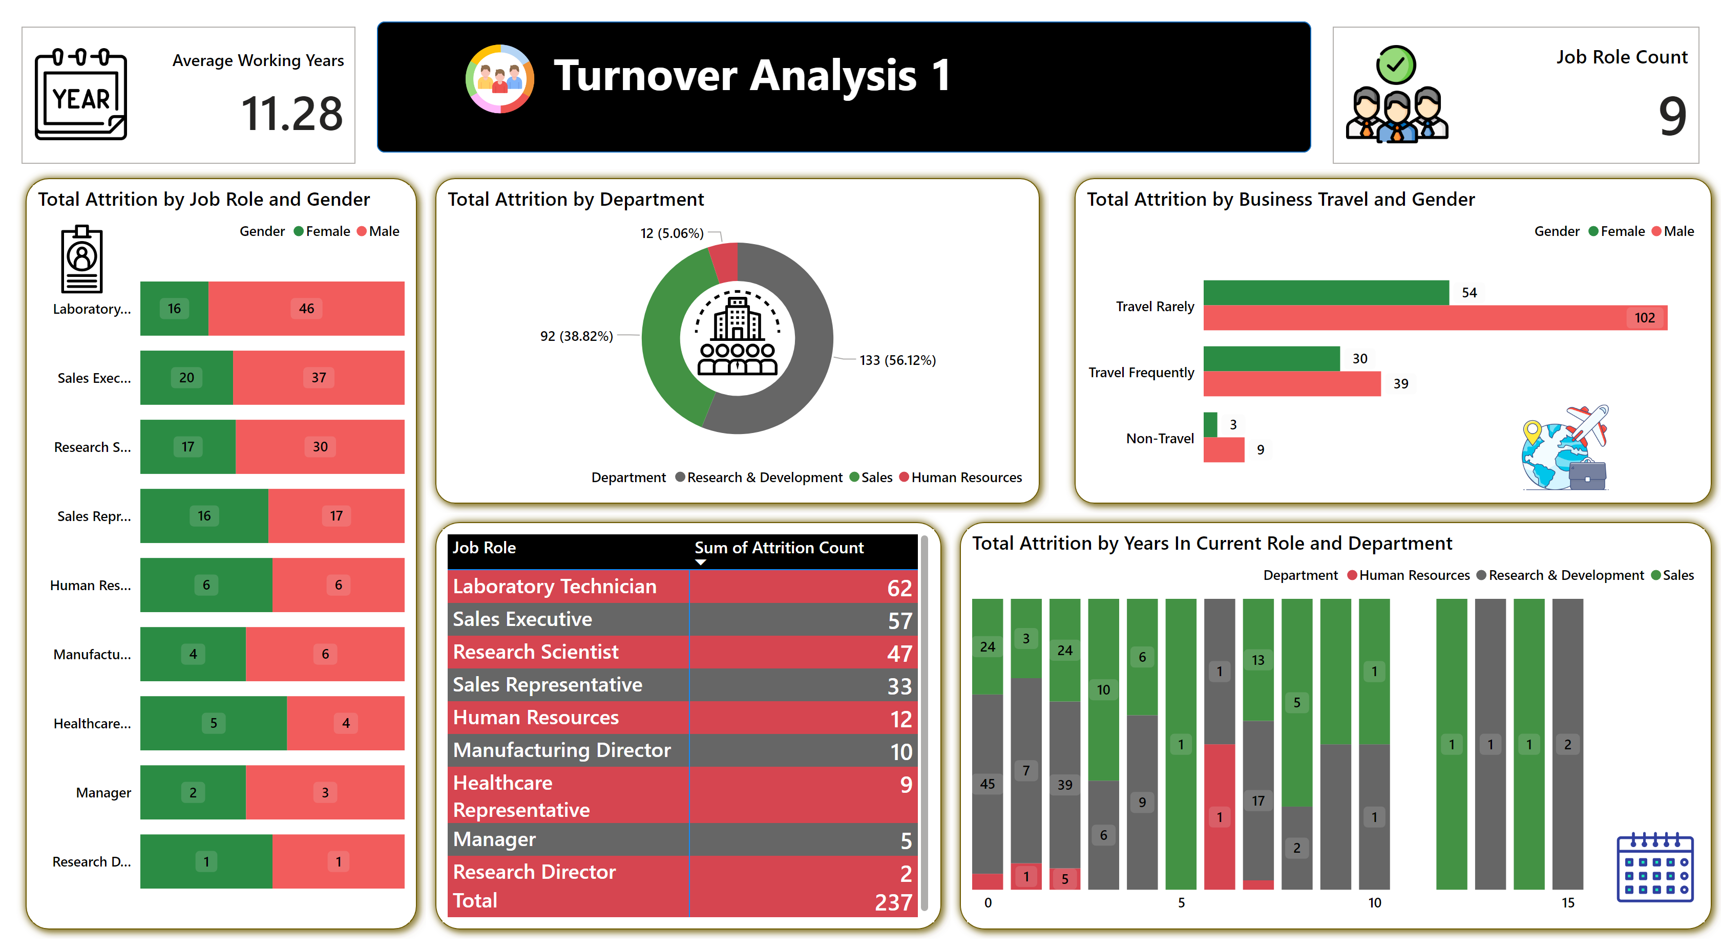
Turnover Analysis 1
Notes:
shape
No alt text provided
textbox
No alt text provided
shape
No alt text provided
image
No alt text provided
Total Attrition by Job Role and Gender
No alt text provided
shape
No alt text provided
shape
No alt text provided
Total Attrition by Department
No alt text provided
Total Attrition by Business Travel and Gender
No alt text provided
shape
No alt text provided
shape
No alt text provided
Total Attrition by Years In Current Role and Department
No alt text provided
pivotTable
No alt text provided
cardVisual
No alt text provided
cardVisual
No alt text provided
image
No alt text provided
image
No alt text provided
image
No alt text provided
image
No alt text provided

Slide 5
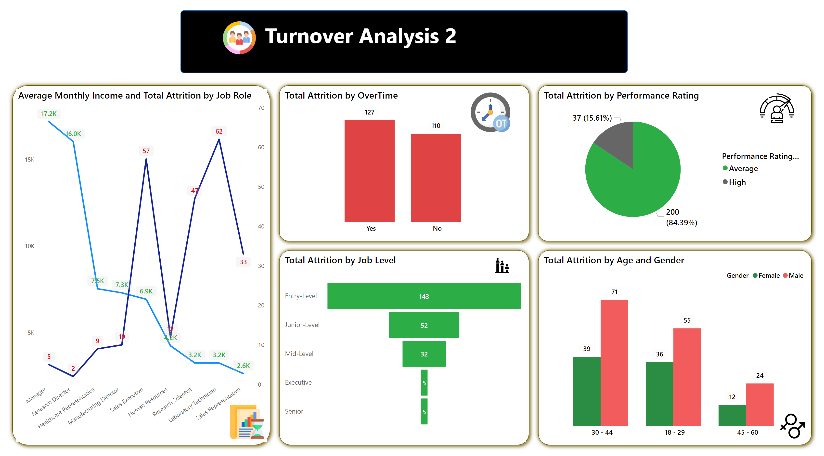
Turnover Analysis 2
Notes:
shape
No alt text provided
textbox
No alt text provided
shape
No alt text provided
image
No alt text provided
shape
No alt text provided
shape
No alt text provided
shape
No alt text provided
shape
No alt text provided
Total Attrition by OverTime
No alt text provided
image
No alt text provided
Total Attrition by Performance Rating
No alt text provided
Total Attrition by Job Level
No alt text provided
Total Attrition by Age and Gender
No alt text provided
Average Monthly Income and Total Attrition by Job Role
No alt text provided
image
No alt text provided
image
No alt text provided
image
No alt text provided
image
No alt text provided

Slide 6
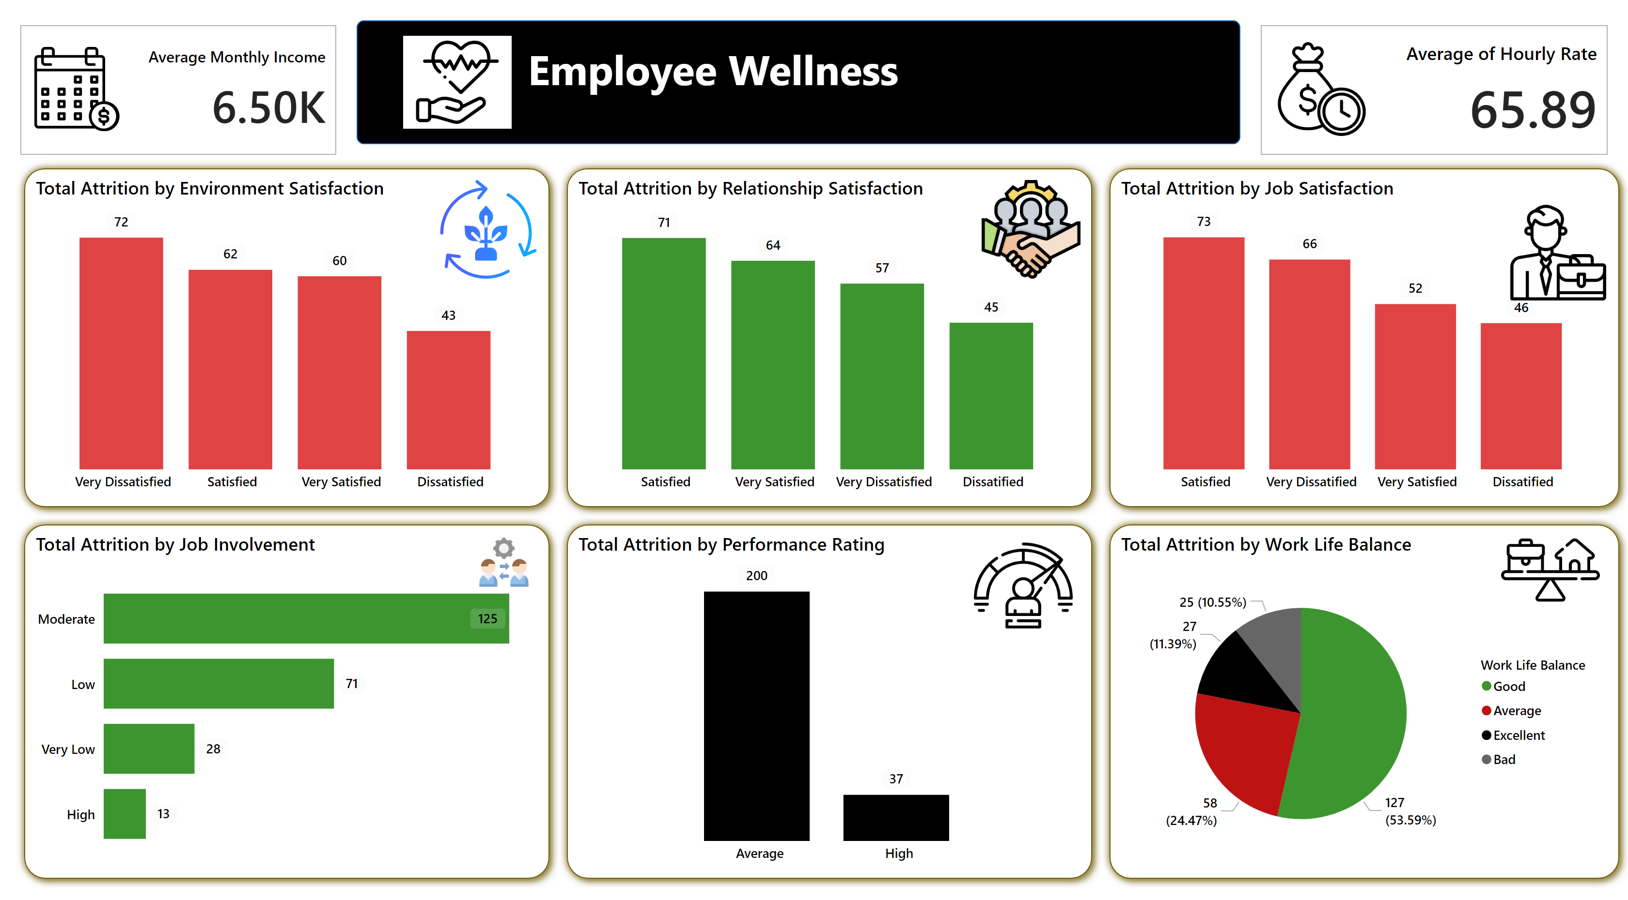
Employee Wellness
Notes:
shape
No alt text provided
shape
No alt text provided
shape
No alt text provided
shape
No alt text provided
shape
No alt text provided
shape
No alt text provided
cardVisual
No alt text provided
cardVisual
No alt text provided
textbox
No alt text provided
image
No alt text provided
shape
No alt text provided
Total Attrition by Environment Satisfaction
No alt text provided
Total Attrition by Relationship Satisfaction
No alt text provided
Total Attrition by Job Satisfaction
No alt text provided
Total Attrition by Job Involvement
No alt text provided
Total Attrition by Performance Rating
No alt text provided
pieChart
No alt text provided
image
No alt text provided
image
No alt text provided
image
No alt text provided
image
No alt text provided
image
No alt text provided
image
No alt text provided

